Slide 1
Cisco Cloud Access Security with Elastica
TDM Presentation
Protect your business with safe cloud app usage
Notes:
My name is ___________ and I’m with Cisco. I’ve been here ___ years. Thanks for taking the time to meet with me today to talk about cloud app security.
T: You know that protecting your business is critical, with new threats lurking in each new technology.
<Click>

Slide 2






Every time you adopt a new technology, you have to secure it
You wouldn’t run your business without email
As your business adopts cloud apps
?
?
?
?
?
?
?
?
?
?
?
And you wouldn’t use email without security
You must secure them
Notes:
Every time you adopt a new technology, you have to adapt your security measures to account for it.
When businesses started using email as a collaboration tool, they realized that data was leaking out of the company and they had to impose security measures.
In this new age of cloud apps, sharing large amounts of data can happen instantly and accidentally, without anybody realizing it happened.
As your business adopts cloud apps, security needs to be a priority.
T: I bet people in your company are using cloud apps you’ve never even heard of.
<Click>

Slide 3


Right now you are blind to cloud app usage
Graphics
Please finish out the no-click animations to build this slide
Should show the user, using cloud apps, the apps appear, others aren’t, some of recognized → this is shadow IT. The shadow casts down and these different documents pop up and then Shadow Data appears
Anything you can do to dress up the slide, user or icon would be great
?
?
Shadow IT
?
?
?
?
?
?
?
?
Shadow Data
PHI related documents
PCI related content
HR documents with SSN
Intellectual property
Notes:
Let’s look at a use case

Slide 4
Users are sharing information freely and it could lead to a breach
Graphics
Please help us take the concept on this slide and balance the graphics, right now its just brainstormed on a slide.
The key story is to show how quickly users can share a document using between departments with cloud apps. It’s starts with just one or two, but soon hundreds of people have access to the document…whether or not they were supposed to have it in the first place.
It keeps being shared and shared until it ends up shared out to another company show in red right now. Should build from left to right, a few users at a time
We need to include the two text boxes with information somewhere in the slide.
This slide is 75% there, we just need you to help us balance the graphics and keep it in the confines of the provided blue border.
Competitor
Payroll.docx
Cloud apps move sharing permissions outside of IT control
20% of broadly shared files contain compliance related data
Notes:
Our research found that on average, 2,037 files per user are resident on cloud file sharing apps. But what is really interesting is that on average, 185 files per user are broadly shared either across the entire organization, with users outside of the enterprise, or publicly. 185 out of 2,037 represents about 9% of files. And, of these broadly shared files, approximately 20% actually contain compliance related data. We can break that down even further. 56% of these compliance relevant files contain PII or personally identifiable information, things like Social Security numbers. 29% contain PHI, or protected health information that might constitute a violation of HIPAA, the health information portability and accountability act. 15% contain PCI, or payment card information. And these statistics were taken from applications that were actually sanctioned and approved.

Slide 5
Cloud access security is your responsibility
App Providers
Businesses
Cloud Apps
75% of mobile apps fail basic security tests¹
… and developers can’t control your user behavior
Source: 1: Gartner
Notes:
Maybe you think that using cloud apps delegates the security responsibility to providers. While some cloud app providers do build great security into the cloud app, not all do. In fact, 75% of mobile apps fail basic security tests. And because an average business uses a few hundred cloud apps regularly, your data is not as secure as it should be.
Now, even if they do provide security – they can’t control any risky behavior of your users. The way your users share files through those apps has no restrictions. Even one disgruntled employee with broad security permissions could do irreparable damage to your company’s reputation by using cloud apps inappropriately. Roughly 60% of data breaches are caused by insiders either abusing their access to company information, or making an innocent mistake.
T: Either way, your business is exposed.
<Click>

Slide 6
We can help. Cisco Cloud Access Security with Elastica delivers
SaaS Visibility
Extended Granular Control
Intelligent Protection
Monitor cloud app usage in real time
Gain control of a cloud-first, mobile-first world
Combat evolving threats using data science

Slide 7













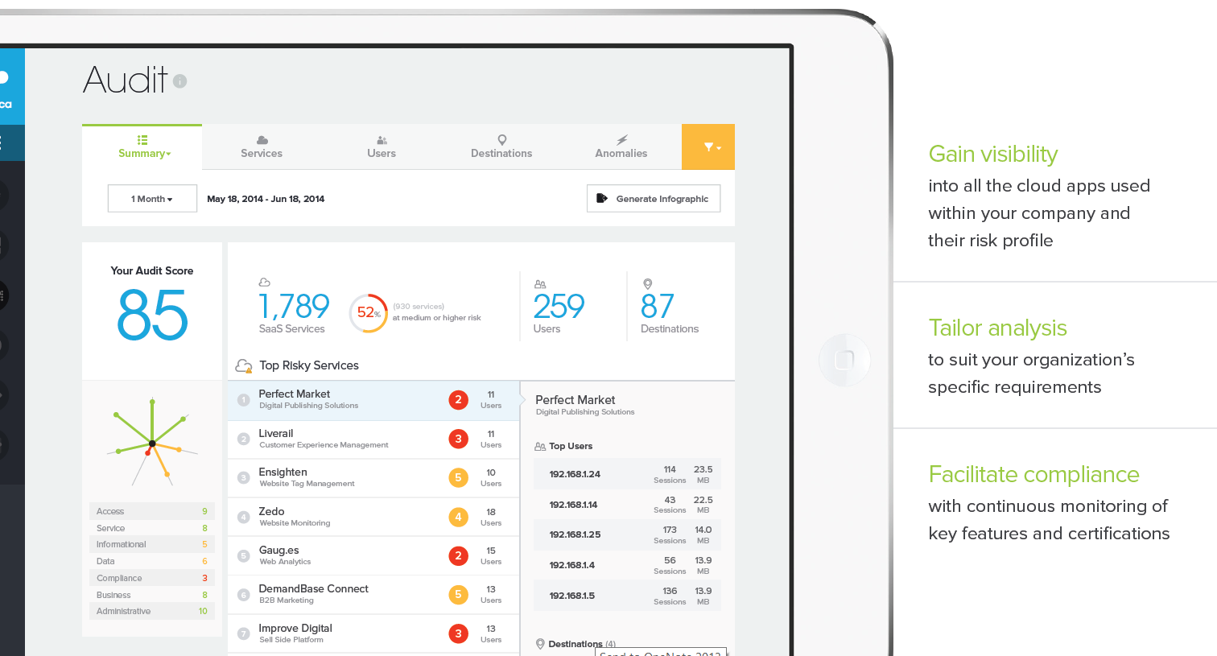
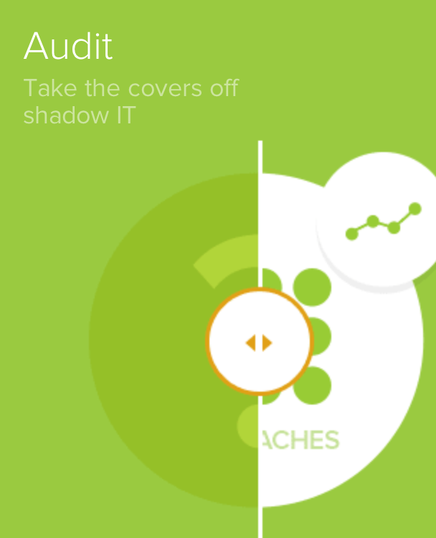
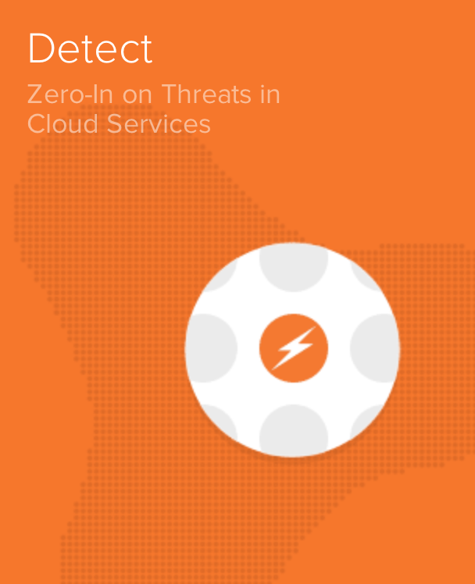
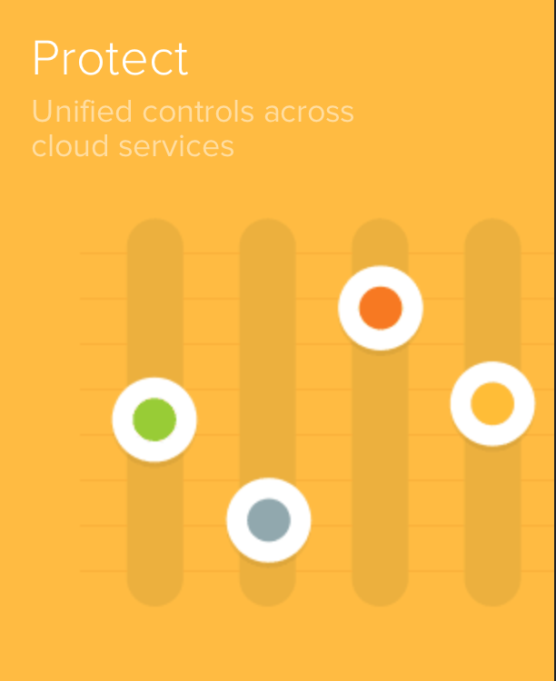
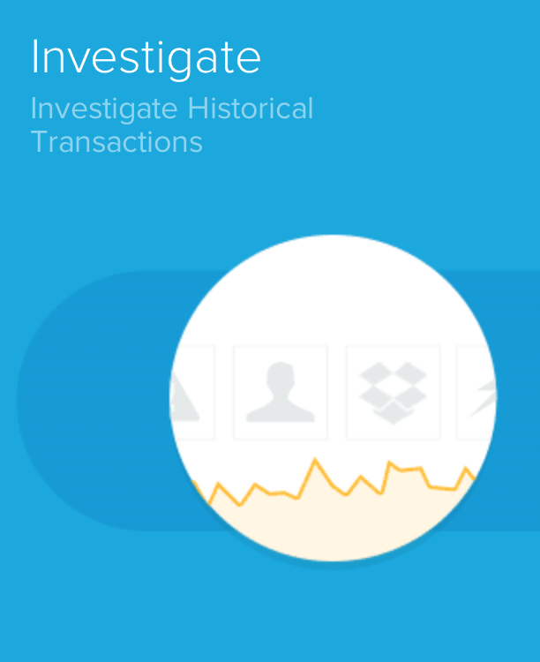

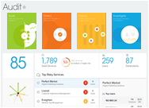
In collaboration with:
Cisco Cloud Access Security
WSA
Cloud Apps
?
?
?
?
?
?
?
?
?
?
Shadow IT Risk Assessment Report
?
Audit Score
Business Readiness Rating™
ASA
Audit
Before
Shadow Data Risk Assessment
Other Appliances
StreamIQ™
Analyze & Control
ThreatScore™
Securelet™
IO IOI
Gateway
IO IOI
ContentIQ™
Security Operations Center
IO IOI
17
54
Detect
IO IOI
Data
Account
User
Reports & Analysis
During
Protect
Cloud SOC Policy
IO IOI
IO IOI
IO IOI
IO IOI
Investigate
IO IOI
After
Elastica CloudSOC™

Slide 8

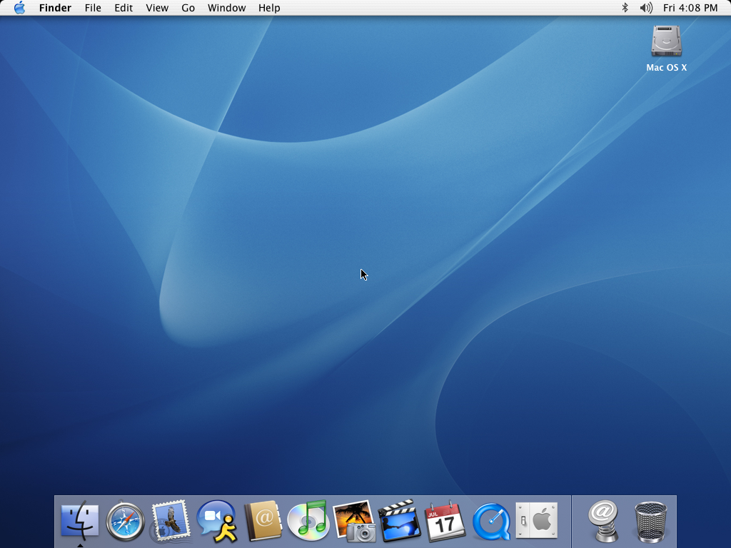
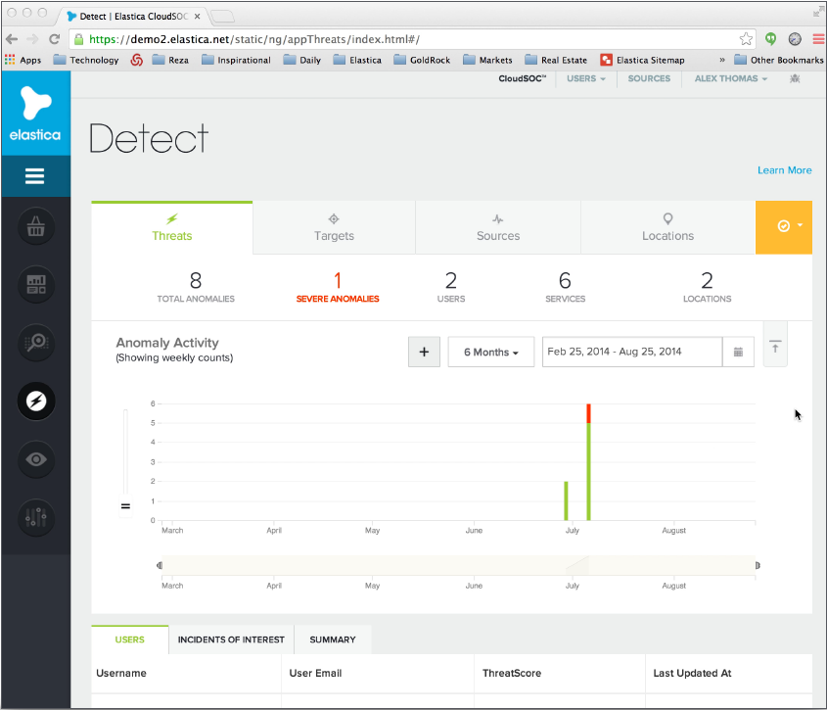
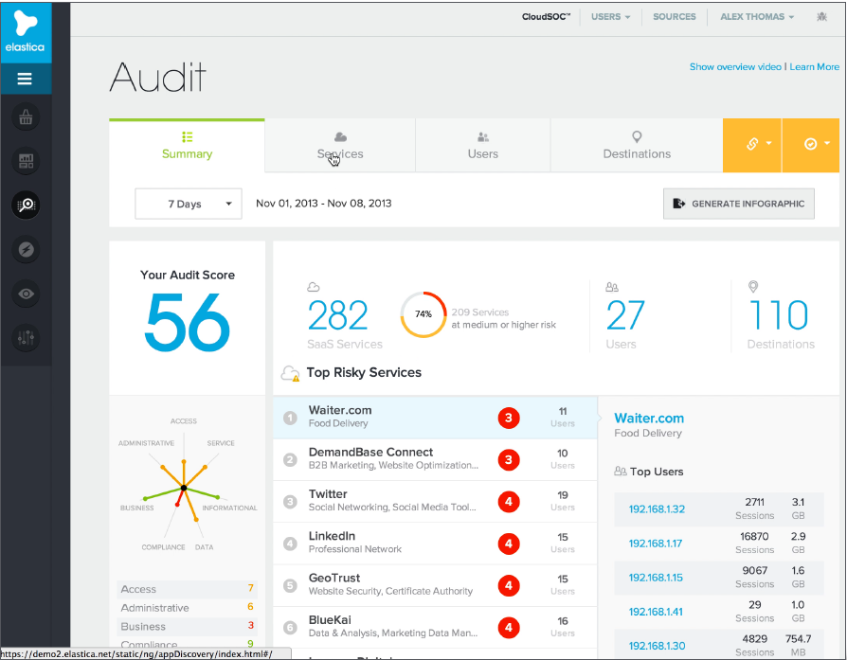
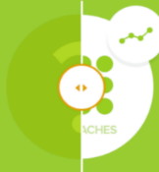
Identify which cloud apps are being used in your environment
Graphics
We need to incorporate the breadcrumb moving along with the discussion. Basically the boxes on the left will scroll along as you walk through the deck.
Please use the new breadcrumbs on slide 23 when you build out the animation
Please add no-click animations to build this slide after the breadcrumb scrolls into place.
See analysis on cloud apps and compliance risks
1
Audit
Business Readiness Score
Please replace with new breadcrumb boxes from slide 23
Understand app usage anomalies
Audit
2
Compare and consolidate cloud app usage
3
View rich analysis on risky apps
4
Sanction & block apps methodically
5

Slide 9
Determine the apps that are best for your business
Graphics
Please use the new breadcrumbs on slide 23 when you build out the animation
Please animate the breadcrumb moving from the last slide, to this slide.
Please add no-click animations to build this slide out after the breadcrumb scrolls into place.
Could be cool to have the lines on the graphic to the left appear individually in a spiraling pattern
Could be cool if the Red number in the middle counts up very quickly and then lands on 38, same with the numbers of the right side.
Compliance
Access
Data
38
40
Business
Service
28
Business Readiness Score
Audit Score
Informational
Please replace with new breadcrumb boxes from slide 23
1
Data
75
Informational
Compliance
28
Administrative
Readiness Rating
Shadow IT Risk Assessment
Business
92
Administrative
Service
82
Access
Analyze critical features across 7 business criteria
View 60+ metrics about each apps discovered in environment
Understand where apps fall short of chosen security criteria
Discover alternative apps to replace risky ones
1
2
3
4
Notes:
Multifactor authentication

Slide 10
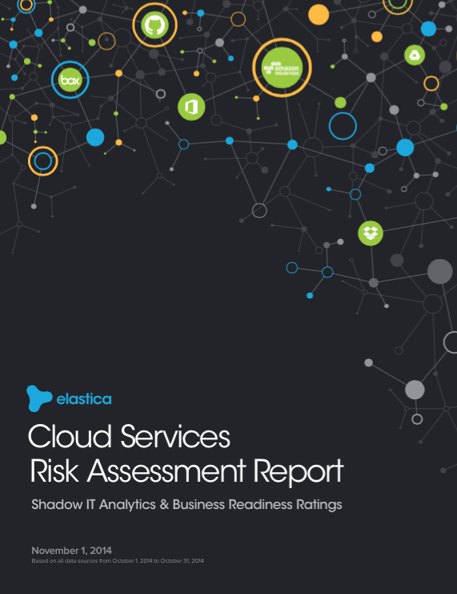
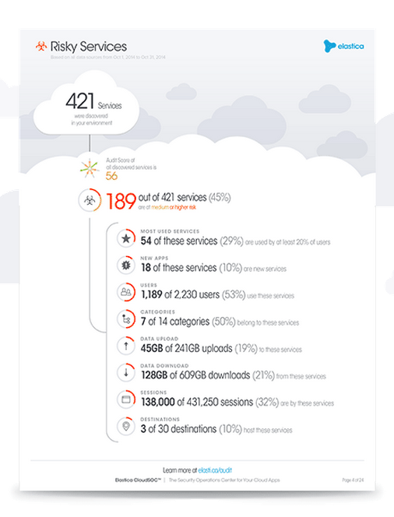
Assess your exposure and company risk
Graphics
Please use the new breadcrumbs on slide 23 when you build out the animation
Please animate the breadcrumb moving from the last slide, to this slide.
Please add no-click animations to build this slide out after the breadcrumb scrolls into place.
Put space for three high level information in the place of the blu box. I will populate tomorrow. Make them look different form the bullets below
Audit Score
Control & Analyze
Please replace with new breadcrumb boxes from slide 23
Shadow IT Risk Assessment
Securelet
Elastica
Gateway
Generate a summary report card for your organization
Identify all cloud apps used and the risks they pose
Obtain a top level statistical view of your organization’s risk profile
Discover risky users and app locations
1
2
3
4
Notes:
Take this assessment after we are done

Slide 11










Redirect your traffic through Cisco Cloud Access Security
Graphics
Please use the new breadcrumbs on slide 23 when you build out the animation
Please animate the breadcrumb moving from the last slide, to this slide.
Please add no-click animations to build this slide out after the breadcrumb scrolls into place. Should build out securelets first, then the content under elastic gateway
Securelets
Elastica Gateway
Control & Analyze
Detect
Please replace with new breadcrumb boxes from slide 23
Securelet
Elastica
Gateway
…and many more
Notes:
Once you connect your user traffic is directed through the elastic gateway or pulled via our API’s, you gain visibility into 50-100 applications without any reason to modify or change the URL of the site.
Blurb about Shadow Data Risk Assessment report: Find and monitor all cloud app transactions by your organization and highlight any risks and compliance issues. The platform incorporates multiple input sources including real-time traffic from transparent gateways between organizations and their cloud services used, API interfaces, and firewall logs from a variety of vendors.

Slide 12

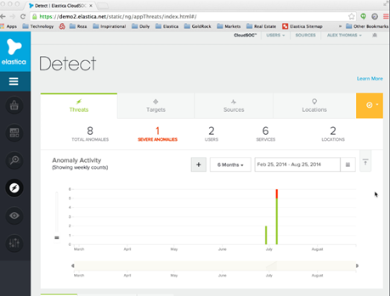
Monitor cloud users, accounts and find malicious activity
Graphics
Please use the new breadcrumbs on slide 23 when you build out the animation
Please animate the breadcrumb moving from the last slide, to this slide.
Please add no-click animations to build this slide out after the breadcrumb scrolls into place.
Extract user activity through StreamIQ
1
Detect
StreamIQ
Please replace with new breadcrumb boxes from slide 23
Learn normal per-user behavior
2
Detect and record intrusions
3
Assign a ThreatScore™ to individual user accounts
4

Slide 13
Interpret and understand gateway traffic in real time
Graphics
Please use the new breadcrumbs on slide 23 when you build out the animation
Please help us build a new “processor” that is in line with the theme and style of the deck.
Please animate the breadcrumb moving from the last slide, to this slide.
Please add no-click animations to build the data point after the breadcrumb rolls into place.
Here we are showing that gateway traffic is being interpreted by their StreamIQ algorithm and is interpreted into actions that the admin sees in their UI.
The graphic should show data (in bianary) entering the “processor” the arrows spinning quickly, and then spitting out the first event. Should fill This process should repeat for all the 5 events. It should happen fairly quickly.
The first event should spit out, but should be at the top (where the fifth event is currently). Then when the second event comes out, it should shift down. When the third comes out, the first two should shift down. And so on until all 5 are up.
Please do not include the blue arrows or numbers in the final graphic.
Events
10 1001 01 0011 11 01000
Service
Message
5
[Alert] alex.thomas@elastic.me attempted to share “Customer list” Alex Thomas | Aug 25, 2014, 7:38:55 PM | Critical
Salesforce
StreamIQ
ThreatScore
X
Please replace with new breadcrumb boxes from slide 23
Processor
4
User viewed Accounts
Alex Thomas | Aug 25, 2014, 7:38:54 PM | Informational
Salesforce
i
3
User viewed Accounts
Alex Thomas | Aug 25, 2014, 7:38:54 PM | Informational
Salesforce
i
2
[Alert] alex.thomas@elastic.me attempted to share “Top Secret” Alex Thomas | Aug 25, 2014, 6:38:52 PM | Critical
Box
X
1
User viewed contents of folder “Customer Documents”
Alex Thomas | Aug 25, 2014, 6:42:38 PM | Informational
Box
i
Convert traffic data into human-readable events lists
Determine how cloud services are being used by individual users
Automatically identify new cloud services
Extend security policies to new services faster
1
2
3
4

Slide 14

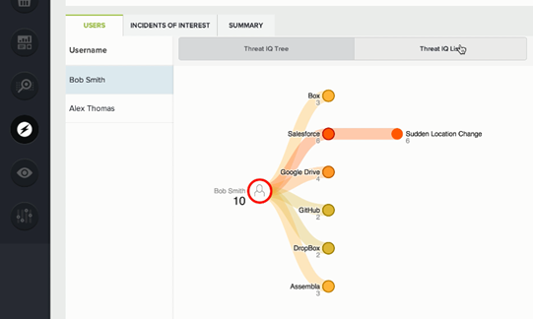

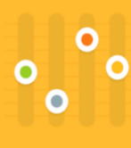
Find problematic users automatically
Graphics
Please use the new breadcrumbs on slide 23 when you build out the animation
Please animate the breadcrumb moving from the last slide, to this slide.
Please add no-click animations to build this slide out after the breadcrumb scrolls into place.
Put space for three high level information in the place of the blu box. I will populate tomorrow. Make them look different form the bullets below
This can be similar to slide 10
ThreatScore is based on:
The number of apps being used
Pace of file sharing
ThreatScore
Protect
Please replace with new breadcrumb boxes from slide 23
Automatically analyze user data assembled by StreamIQ
Surface problematic users and user accounts in real-time
Highlight risk level of specific activities
Flag suspicious behavior for investigation
1
2
3
4

Slide 15
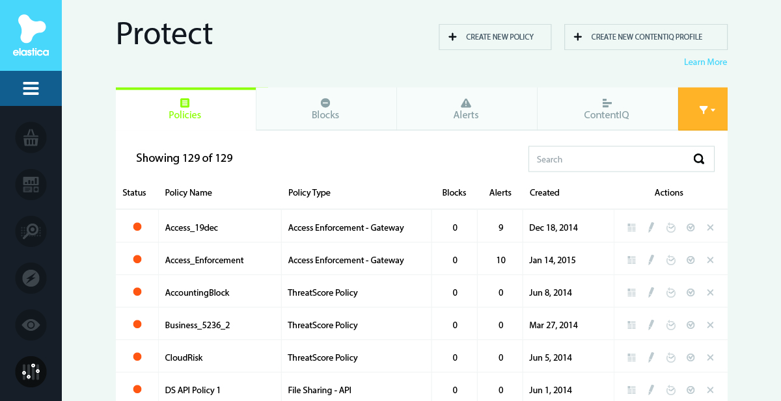
Create and enforce policies across all users and accounts
Graphics
Please use the new breadcrumbs on slide 23 when you build out the animation
Please animate the breadcrumb moving from the last slide, to this slide.
Please add no-click animations to build this slide out after the breadcrumb scrolls into place.
Control and remediate across all cloud services from a single interface
1
Protect
ContentIQ
Please replace with new breadcrumb boxes from slide 23
Set policies based on user, user activities, device or geography
2
Protect content by object type, risk type or content classification with ContentIQ
3
Leverage ThreatScore™ to alert or block transactions in real time
4

Slide 16


Automatically classify, detect and remediate content uploaded to cloud apps
Graphics
Please use the new breadcrumbs on slide 23 when you build out the animation
Please animate the breadcrumb moving from the last slide, to this slide.
Please add no-click animations to build this slide out after the breadcrumb scrolls into place.
The animation should have the 4 boxes along the bottom appear first, then the documents appear left to right, each one with a question mark on them. The magnifying glass should scan back and for and then uncover the true nature of the document. So the question mark disappears and the content appears
ContentIQ
Investigate
?
?
?
?
Please replace with new breadcrumb boxes from slide 23
{ }
SSN
PCI
PII
PHI
Source code
Run semantic analysis on all files in cloud apps
Categorize, flag and remediate critical business information
Automatically identify and fix anomalous permissions
Enforce real-time policies on compliance-related content
1
2
3
4

Slide 17
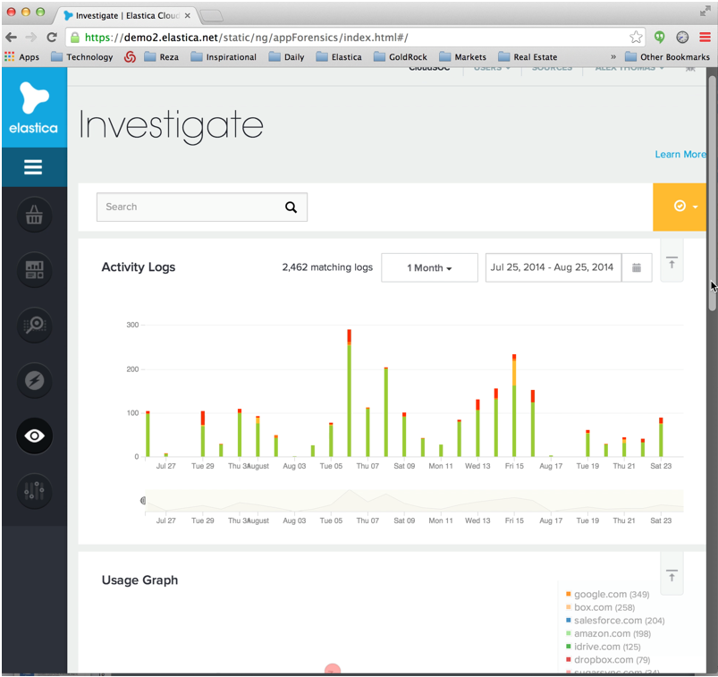
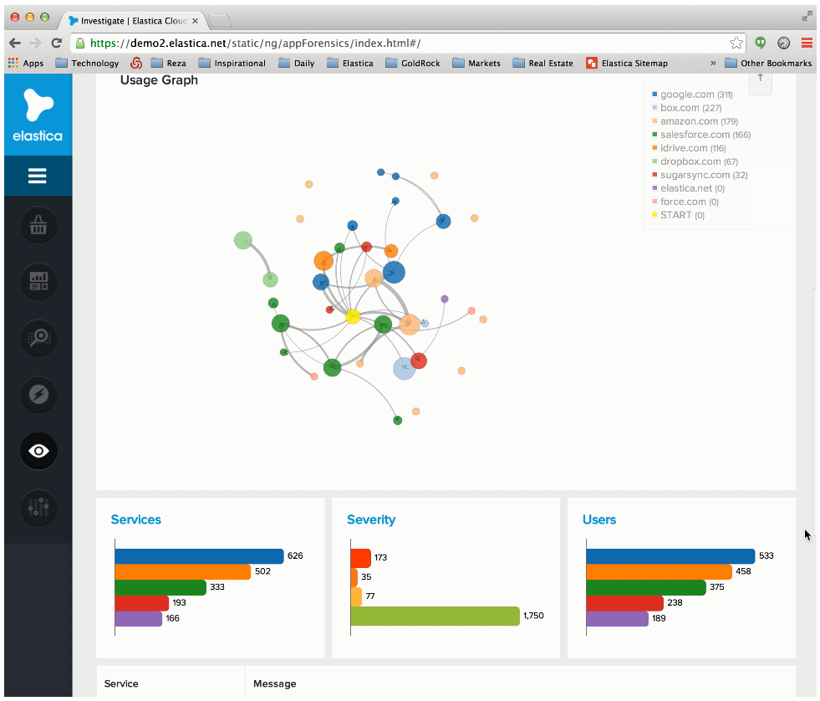
Conduct forensic analysis on historical data
Graphics
Please use the new breadcrumbs on slide 23 when you build out the animation
Please animate the breadcrumb moving from the last slide, to this slide.
Please add no-click animations to build this slide out after the breadcrumb scrolls into place.
Quickly examine historical data to determine where threats originated
1
Investigate
CloudSOC Dashboard
Please replace with new breadcrumb boxes from slide 23
Cross-correlate historical data to across dynamically adjusting time windows to identify patterns
2
Perform deep-dive analysis for legal, compliance and HR initiatives
3
Use pivot tables and free-form text search to quickly find specific information
4

Slide 18
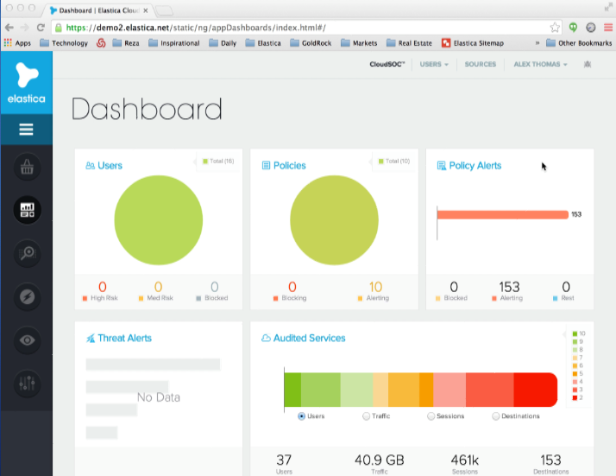
Manage and control all apps from a single interface
Graphics
Please use the new breadcrumbs on slide 23 when you build out the animation
Please animate the breadcrumb moving from the last slide, to this slide.
Please add no-click animations to build this slide out after the breadcrumb scrolls into place.
Intuitive, click-through interface
CloudSOC Dashboard
1
Please replace with new breadcrumb boxes from slide 23
Customizable widgets
2
Executive-level reporting
3
Integrated security app store
4

Slide 19
Elastica CloudSOC delivers the visibility and control needed to secure cloud apps
Graphics
For this slide, please reuse the work done on slide 4
What we want to show here is that Elastica can help prevent this oversharing by remediateing or blocking the sharing as its taking place. So you could show the full scope of the problem (all the users share all the way out) and then put the stop sign in place and make the additional users beyond that stop sign disappear.
Show that the payrole doc can only be shared with the people who are authorized to view the document.
Please call for any questions on this slide or any slide. Happy to walk through all the animations
Please stay in provided border
X
X
Competitor
X
Payroll.docx
X
Notes:
First let’s take a simple use case: Bob shares a file with Alice using Dropbox. If you’re using traditional tools like NGFW, IPS, or URL filtering, this is about all you’d see. Bob connected to Dropbox. But that’s not the entire story here. To have good visibility and control, you also need to know that
1. He shared it from an unmanaged device
2. He made Alice an external collaborator
3. The file contains sensitive information
4. The file was accessed from an anomalous location.
but it’s no that simple

Slide 20
Only Cisco Cloud App Security with Elastica delivers
SaaS Visibility
Extended Granular Control
Intelligent Protection
Monitor cloud app usage in real time
Gain control of a cloud-first, mobile-first world
Combat evolving threats using data science

Slide 21
Next Steps
Take the Shadow IT and Data Risk Assessments
Review the results
Identify problem areas and relevant solutions
1
2
3

Slide 22
Notes:
Thank you.

Slide 23
Audit
Business Readiness Rating
Audit Score
Control & Analyze
Detect
StreamIQ
ThreatScore
Protect
ContentIQ
Investigate
CloudSOC Dashboard
Shadow IT Risk Assessment
Securlet
Gateway

